Slide 1

DATABASE MANAGEMERNT DEPARTMENT OF SOFTWARE ENGINEERING
PROJECT TOPIC
MEDICALSTORE
Name Waseem Akram
BSE -23F-142
Submitted to : Miss AQSA Umer

Slide 2
Medicalstore
Providing Medical Supplies:First Aid Supplies: Bandages, antiseptics, and wound care products.
To create a system for storing and managing information about a medicine store, we need to define the data structure and processes for handling this information. This will include:
Tables for storing medicines, customers, suppliers, and sales.Tables for storing medicines, Example entries for each table to demonstrate the system.customers, suppliers, and sales.Medical

Slide 3
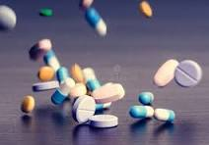

Importance of Medicines
Medicines are essential in modern healthcare for the prevention, treatment, and management of diseases. They help:
Alleviate symptoms and reduce suffering.
Cure infections and other illnesses.
Manage chronic conditions, improving the quality of life.
Prevent diseases through vaccinations and prophylactic treatments.

Slide 4
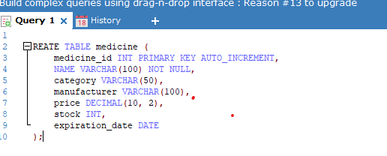
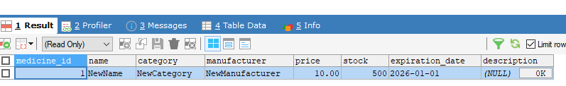

Slide 5
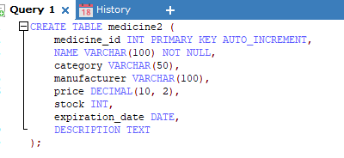

Slide 6
cuncluion
Medical stores are a vital component of the healthcare infrastructure, providing accessible healthcare products and services to the community. The proper use of medicines, guided by knowledgeable pharmacists, can significantly enhance health outcomes and improve the overall well-being of individuals.

Slide 7
he overall well-being of individuals.

